Slide 1


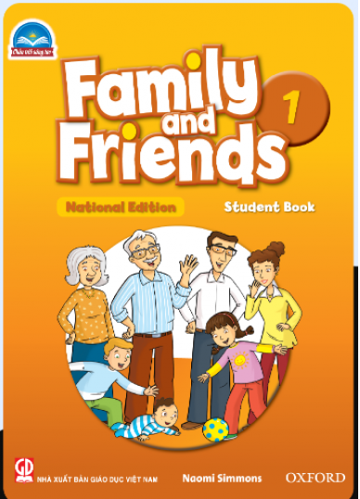

FAMILY and FRIENDS 1
National Edition

Slide 2
FAMILY &FRIENDS 1
National Edition

Slide 3

Unit 1: What color is it?
Lesson 4 NUMBERS

Slide 4


a
C
b
B
A
c

Slide 5

Bb
Aa
Cc

Slide 6







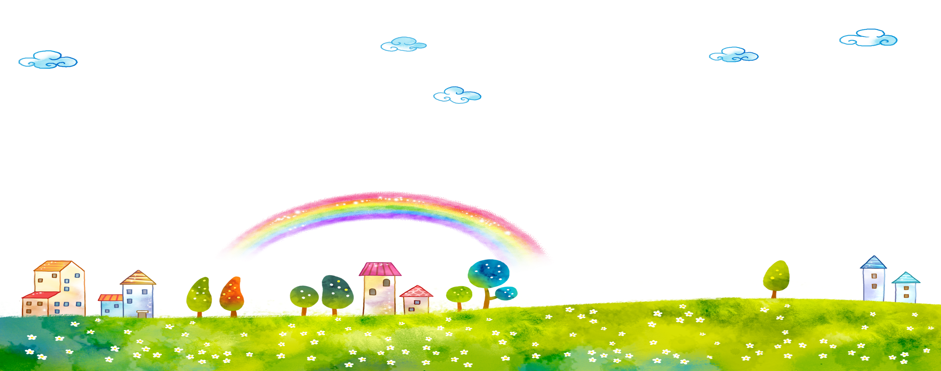







Slide 7





Notes:
Count: “one, two, three”
Say “three”. Ask students to repeat.
Draw dotted outlines of the number 3 on the board and demonstrate how to write it.
Do the same steps to teach number 4

Slide 8



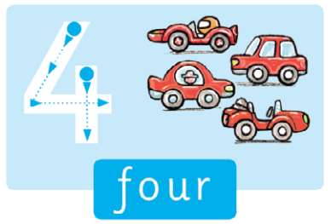



Slide 9

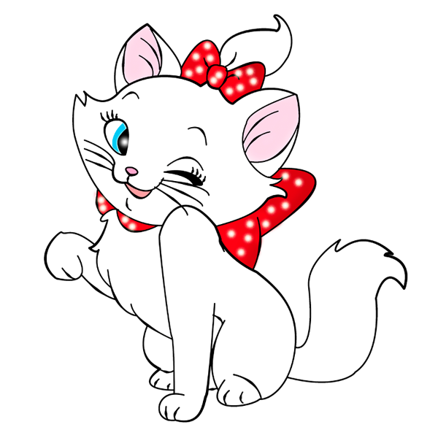
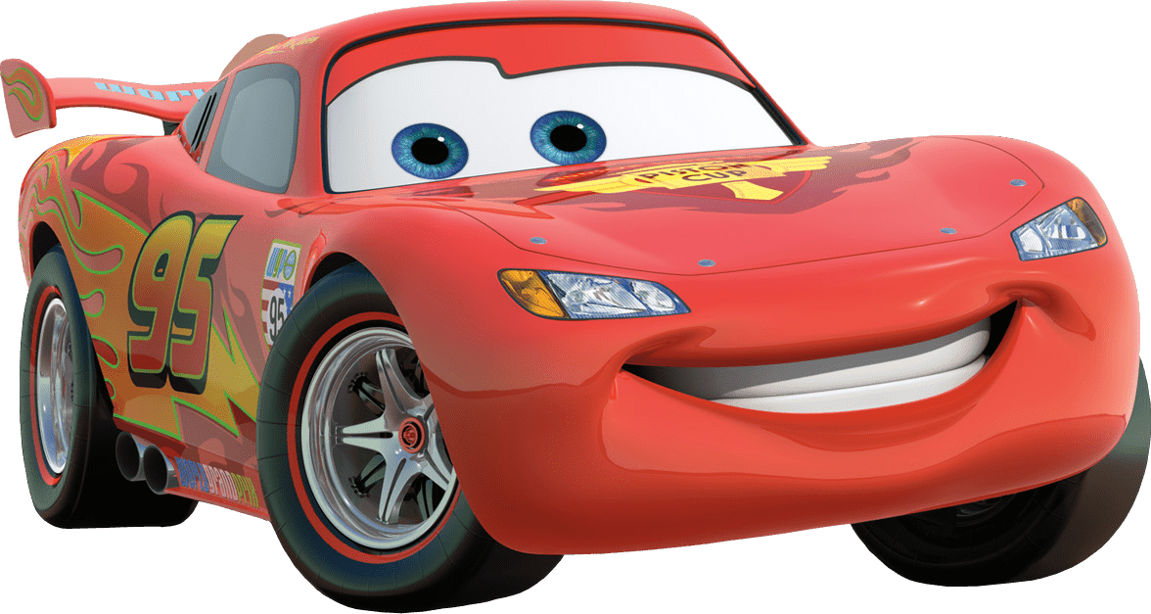



Notes:
1. Listen, point, and repeat. Write. Track 21
- Play track 21, listen and point
- Play again, ask students to listen and point
- Play again, ask students to listen and repeat
- Model the writing activity
- Ask students to trace and write the numbers
2. Point and sing: track 22
- Point to the picture and count.
- Ask students to repeat
- Read the song. Ask students to repeat.
- Play all of the song
- Ask students to listen and point to the pictures as they hear the words.

Slide 10

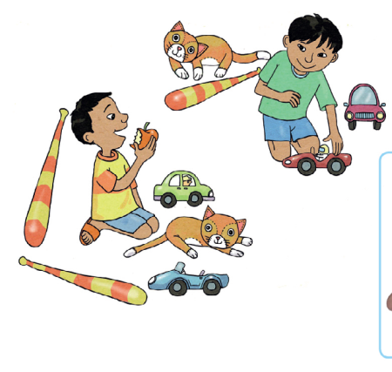




Notes:
Count, circle, and say.
- Point to the picture and say: boy, apple, car, bat, cat.
- Point to the two boys and count: one … two … two boys.
- Encourage the children to count and circle with you.
- Point to the apple in the box and then point to and circle the apple in the main picture. Say: one … one apple.
- Continue with car, bat and cat

Slide 11





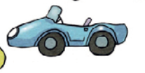
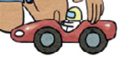
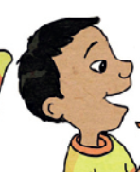



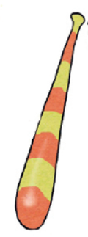
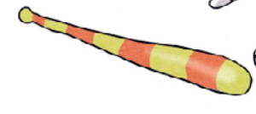





Notes:
Below level: after counting each item, draw it and write the number on the board next to it for visual support.
At level: ask students to draw the number answers in the air each time you have finished counting.
Above level:
Ask the students to ‘draw’ their answers (they will draw two boys’ faces, one apple … etc.)
Ask students to say what they have drawn: two boys, one apple, … etc.

Slide 12
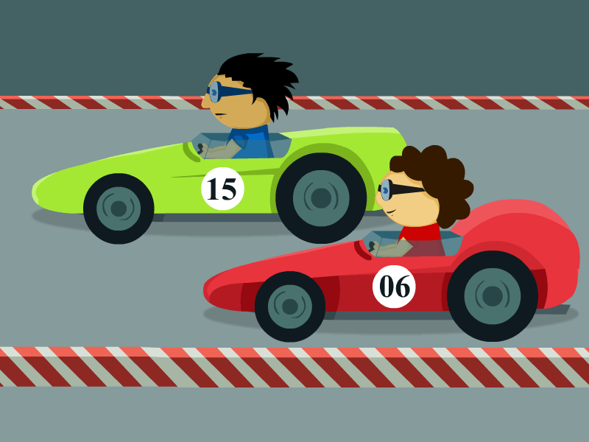
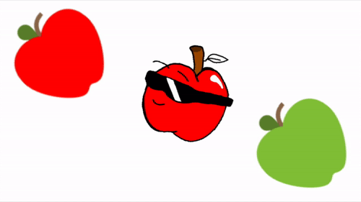
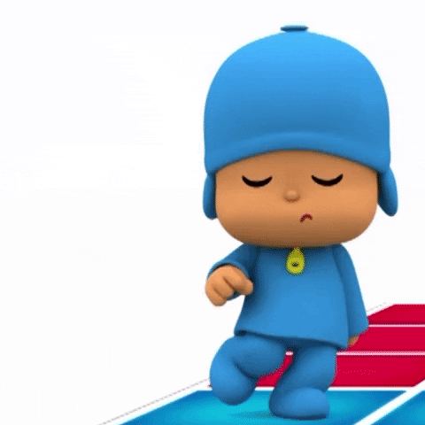
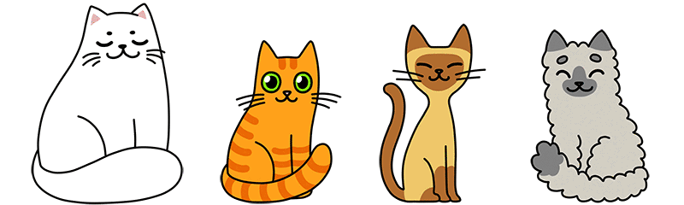
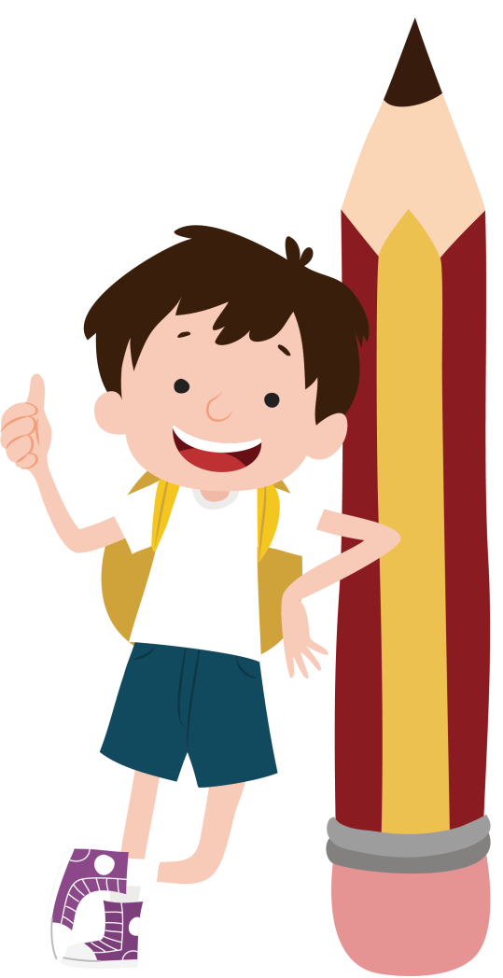
LET’S TALK
Notes:
Point to a picture of three cats. Say THREE.
Ask: Three what? to elicit the answer: Three cats
Students work in pairs and take turns holding up 3 or 4 of the same things, and saying the correct numbers and words.

Slide 13


Goodbye !

